Slide 1

Model
View
Controller
Trainer xhevat.ibraimi@gmail.com
Assistant dejan.obradovikj@seavus.com

Slide 2
Module Contents
ASP.NET MVC
MVC Concept
Controllers
Controller Actions
Controller Action Return Types
Views
Razor View Engine
Partial Views And HTML Helpers
Naming Convention
Code academy @ Skopje, 2018-2019

Slide 3
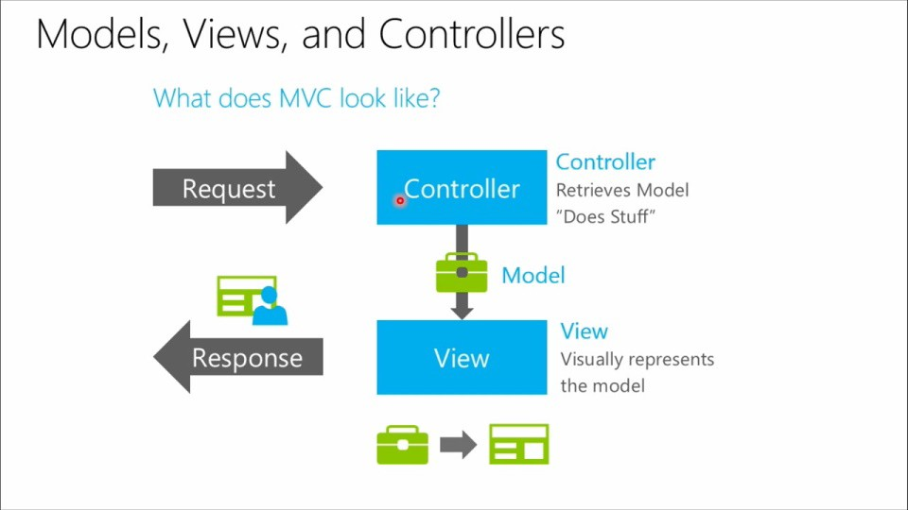
MVC Concept
ASP.NET MVC
Code academy @ Skopje, 2018-2019

Slide 4
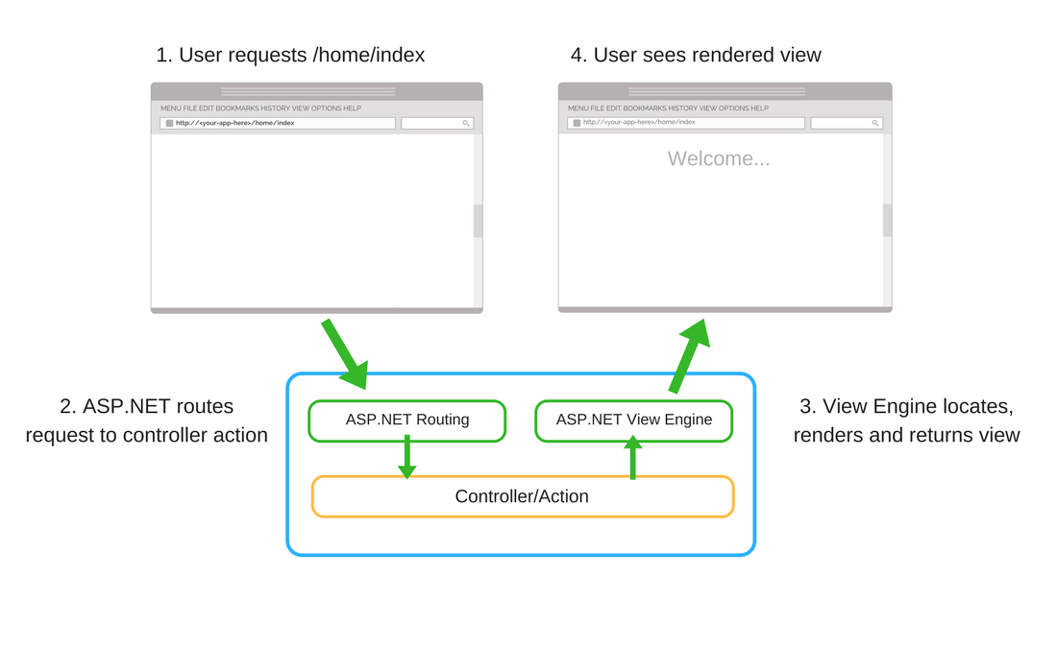
Controllers
ASP.NET MVC
Code academy @ Skopje, 2018-2019

Slide 5
Controller Actions
ASP.NET MVC
Represent an endpoint of the Web Application
Controller can also have multiple actions
Can be used for routing
Can take binded parameters from the http request
Can have various return types
Code academy @ Skopje, 2018-2019

Slide 6
Controller Action Return Types
ASP.NET MVC
Result Class | Description
ViewResult | Represents HTML and markup.
EmptyResult | Represents No response.
ContentResult | Represents string literal.
FileContentResult/ FilePathResult/ FileStreamResult | Represents the content of a file
JavaScriptResult | Represent a JavaScript script.
JsonResult | Represent JSON that can be used in AJAX
RedirectResult | Represents a redirection to a new URL
RedirectToRouteResult | Represent another action of same or other controller
PartialViewResult | Returns HTML from Partial view
Code academy @ Skopje, 2018-2019

Slide 7
Demo
ASP.NET MVC
Controller
Controller Action
Create View
Check for other return types
Create controller from templates
Code academy @ Skopje, 2018-2019

Slide 8
Views
ASP.NET MVC
In ASP.NET MVC, the View is a template for generating HTML as response of the http request
Contains mix of C#/VB and HTML
File extensions: .cshtml or .vbhtml
Views allow model binding (...more on this later)
Code academy @ Skopje, 2018-2019

Slide 9
Razor View Engine
ASP.NET MVC
Master Layout views are supported in Aspnet
Allows combination of HTML and C#(or VB) code
@ indicates server side C# or VB code
File extension is .cshtml or .vbhtml
Views should contain as less server side code as possible
Code academy @ Skopje, 2018-2019

Slide 10
Partial Views and HTML Helpers
ASP.NET MVC
Partial views
Allow reusability of razor code
It's a good practice to reuse the code using partial view
Are the lowest element in Views Hierarchy
HTML helpers
Various of html helpers come along with the framework by default(validation,forms,display)
You can create your own custom html helpers
Code academy @ Skopje, 2018-2019

Slide 11
Naming Convention
ASP.NET MVC
Controllers
path: /Controllers/
pattern: [ControllerName]Controller.cs
example: MonstersController.cs
Views
path: /Views/[ControllerName]/actionName
pattern: [ActionName].cshtml
example: /Views/Monsters/EditMonster.cshtml
can have different name than
Code academy @ Skopje, 2018-2019

Slide 12
?
ASP.NET MVC
Code academy @ Skopje, 2018-2019

